Slide 1
A Data Marketing Report for Vestiarecollective.com
Samuel Kohler

Slide 2
Introduction
The data shown represents the activity of our users.
Sadly, we don’t have the value of the sales
More transactions between users generate more income.
But which transaction are preffered?

Slide 3
Cheap Item
Expensive Item
One item sold = 5.49 USD
One item Sold = 10.99 USD

Slide 4
The questions
Q1: Do the use of social features generate more sales?
Q:2 Are socially active users generating more sales compared to non-socially engaged users
Q3: if Q2 is true, what are the factors contributing to more sales?

Slide 5
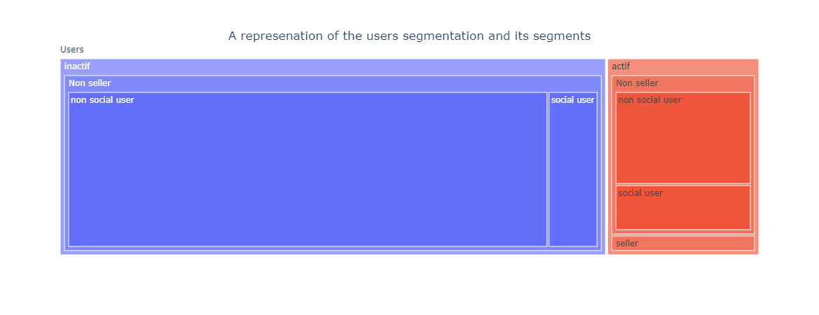
Findings

Slide 6
82% of users are inactive
This is a sign of single visits only

Slide 7
95% of users did not buy any item
There is plenty of room to improve

Slide 8
70 % of buyers are social users
The social features work!

Slide 9
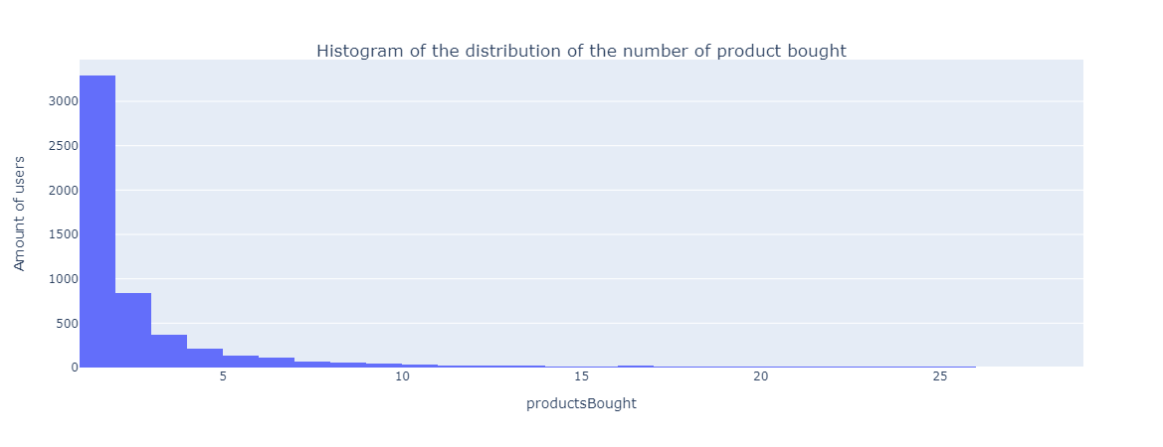
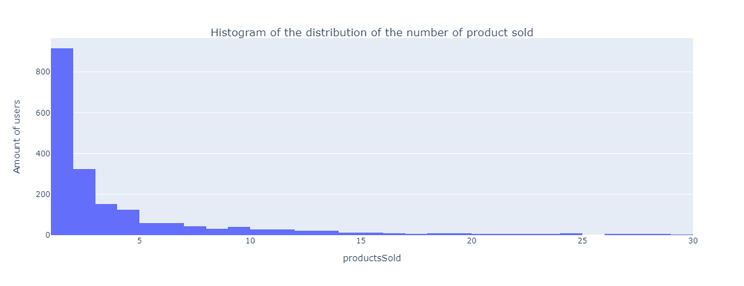
Findings
More than 75% of the users bought less than 2 items
More than 75% of the users sold less than 2 items

Slide 10
The majority are one-time users
Buying or selling one item and never coming back

Slide 11
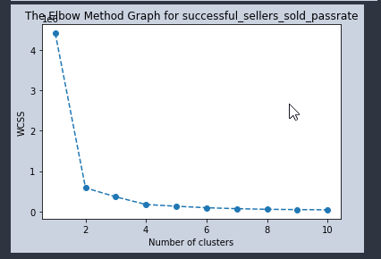
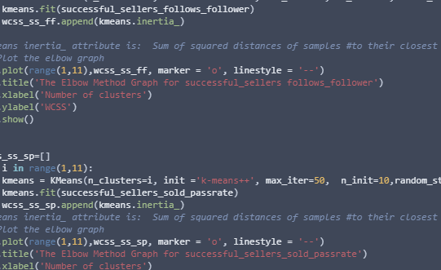
Segmenting

Slide 12
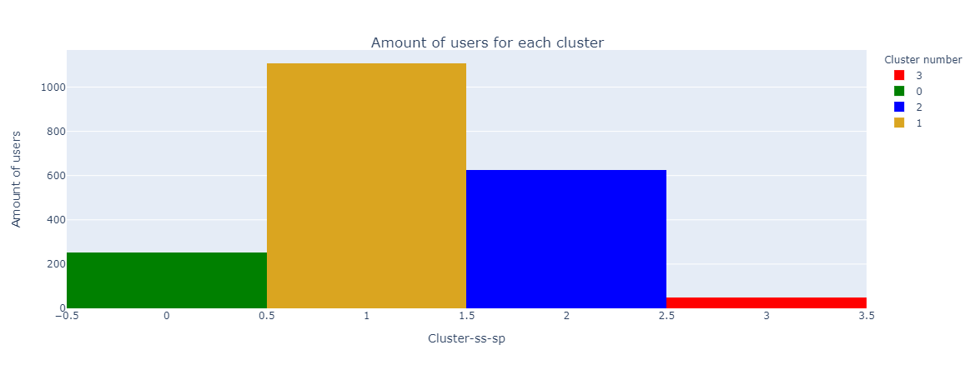
The segments

Slide 13
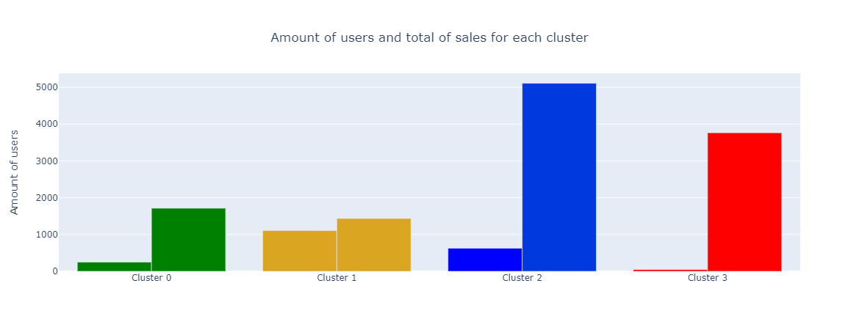
The segment and their sales volume
31% of sales
2.5% of users
10% of sales
56% of users

Slide 14
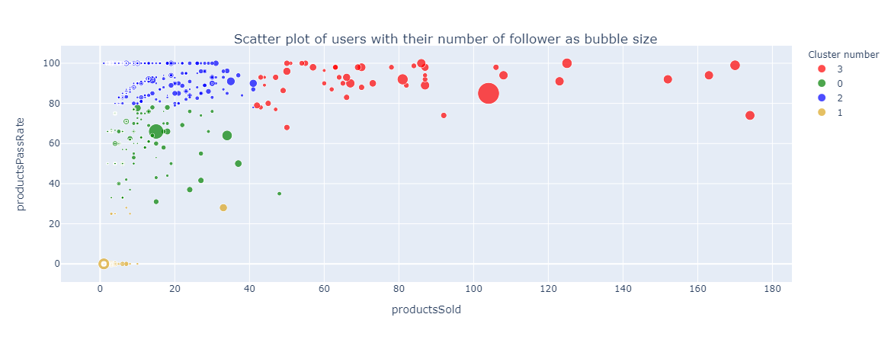
The sellers on a map

Slide 15
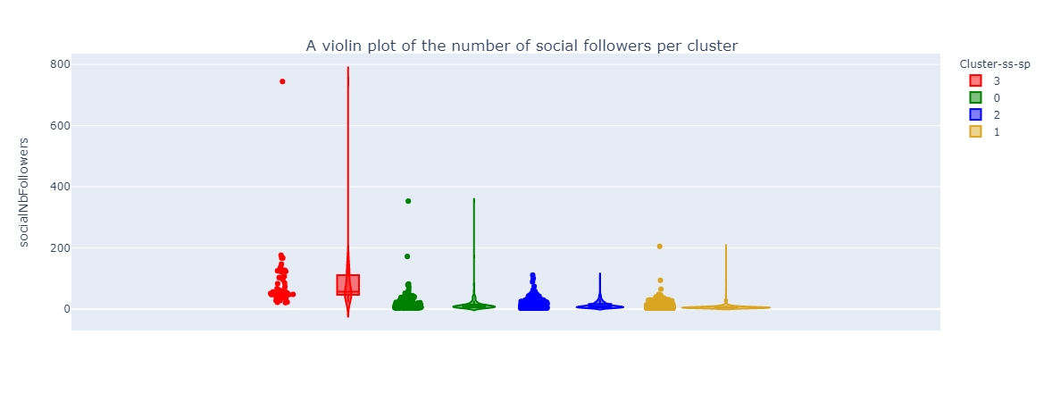
Answer 1 Do the use of social feature generate more sales?
Yes, a higher number of followers will yield more sales, but the correlation is weak.
As a lot of buyers are one timer
The average amount of followers is skewed by high performing individuals.

Slide 16
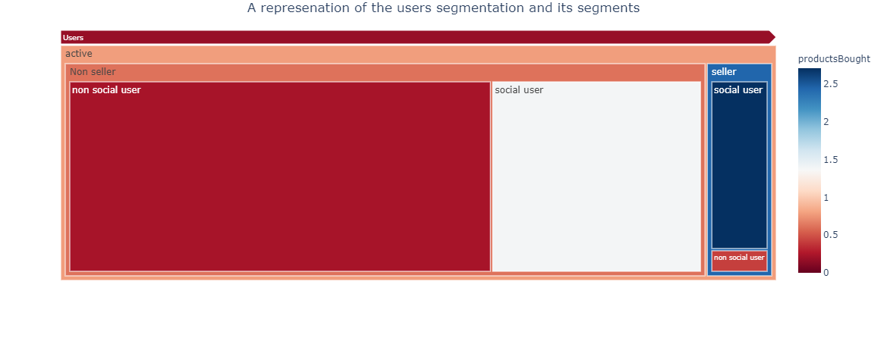
Answer 2 Are socially active users generating more sales compared to non-socially engaged users
Absolutely! The majority of all products was bought by social users

Slide 17
Answer 3 What are the factors contributing to more sales?
Two identified contributing factors to the number of sales are the passRate percentage and the number of followers
=> The higher the passRate, the more sales => However, the number of followers influence the amount of sales but not significantly.

Slide 18
Next steps ?
An email campaign could be setup for the users of cluster 2 to teach them about proper brand building to increase the number of sales.
An education campaign teaching what is an exceptional piece of clothing, answering to the company’s quality standards, could lead to more sales.
For the webdev team, the results show that there is a need to bring back users from their inactivity and make the social features more accessible or usable.

